Slide 1

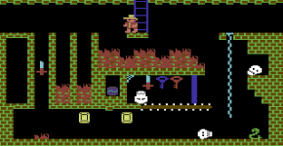
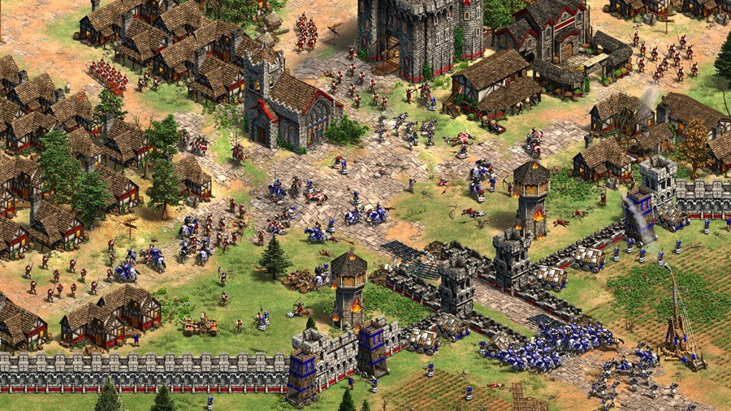
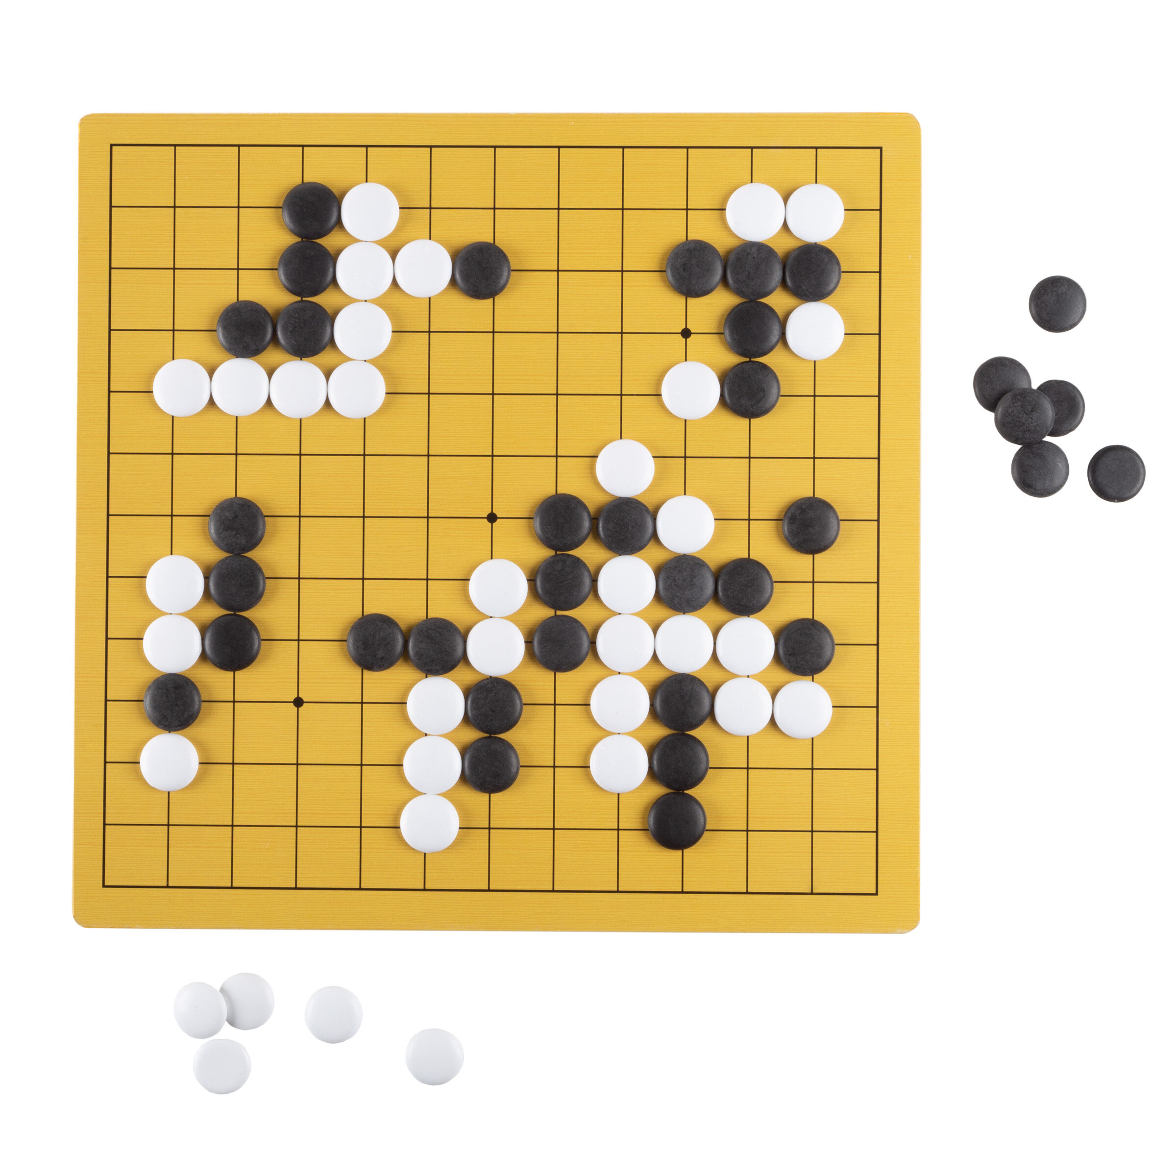
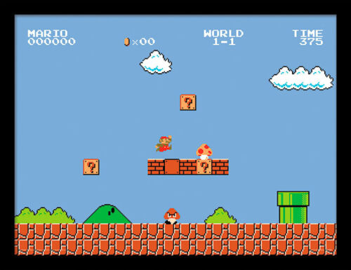
Game AI Programming
Based on Prof. Horst Eidenberger`s Leture on Strategy Game Programming @TU Vienna

Slide 2
Goals
Understand
Minimax algorithm
Alpha Beta Pruning
Monte Carlo Tree Search
Deep Reinforcement Learning (with Azure ML)

Slide 3
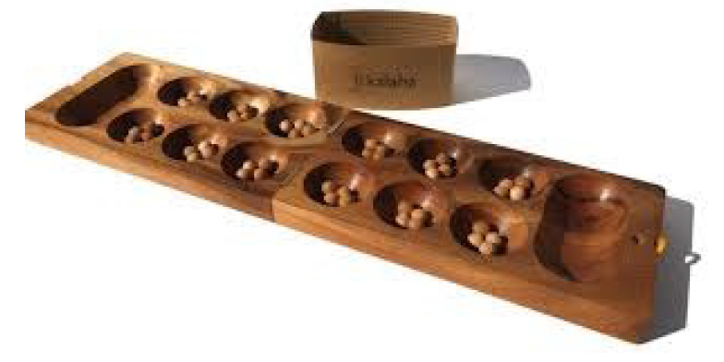
Lab Project
Students should be able to implement a Game AI for the Mancala Game Engine. (by Robert Fischer https://github.com/metzzo )
Agents will play against each other.

Slide 4
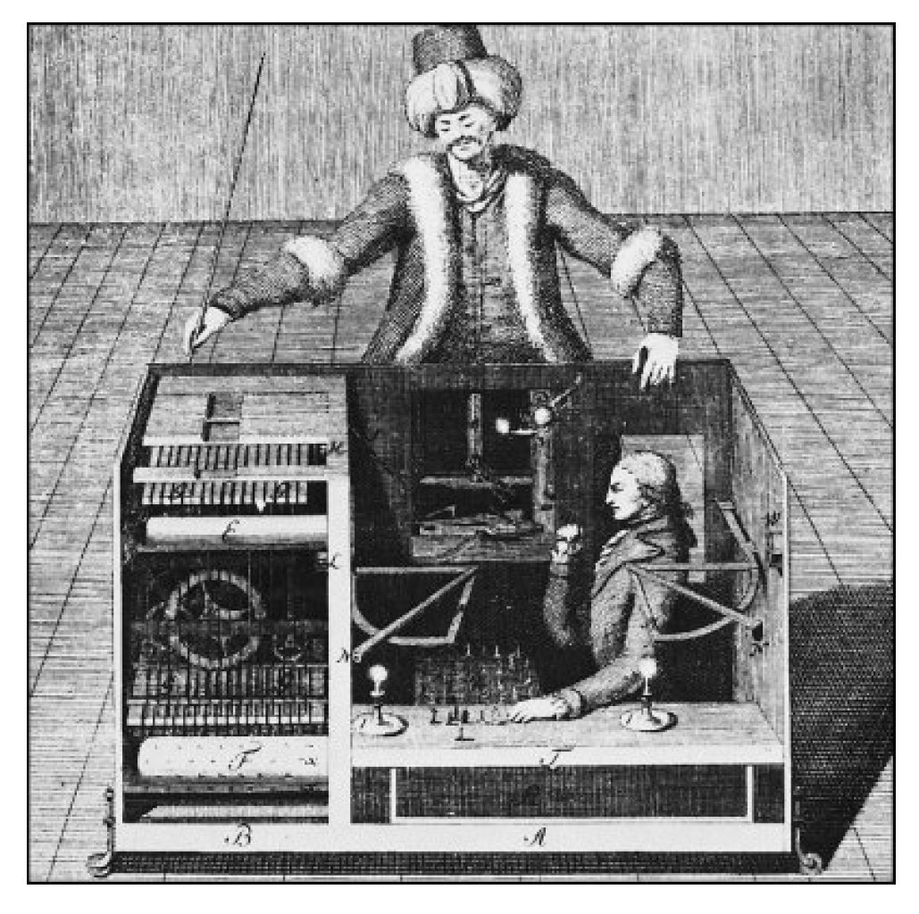
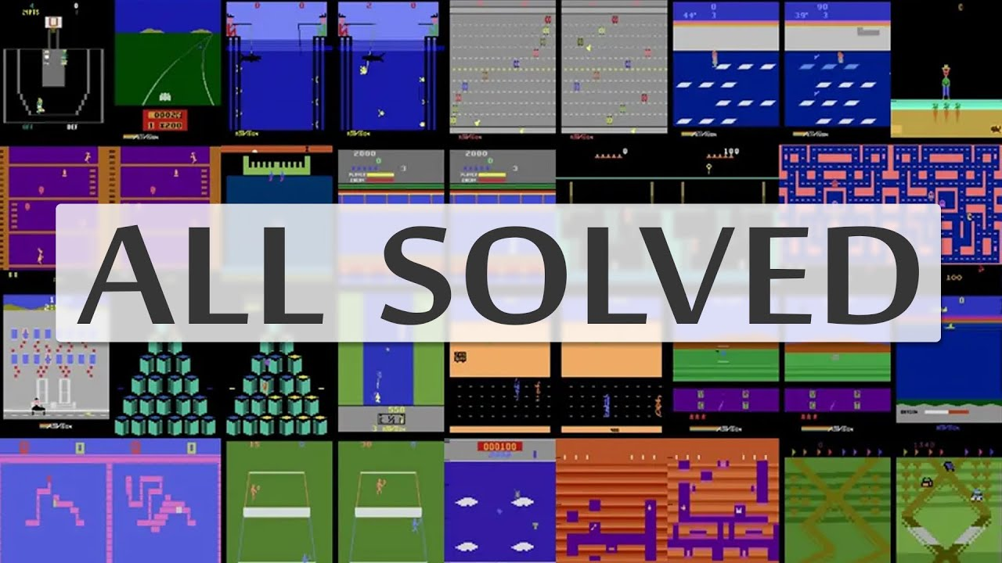
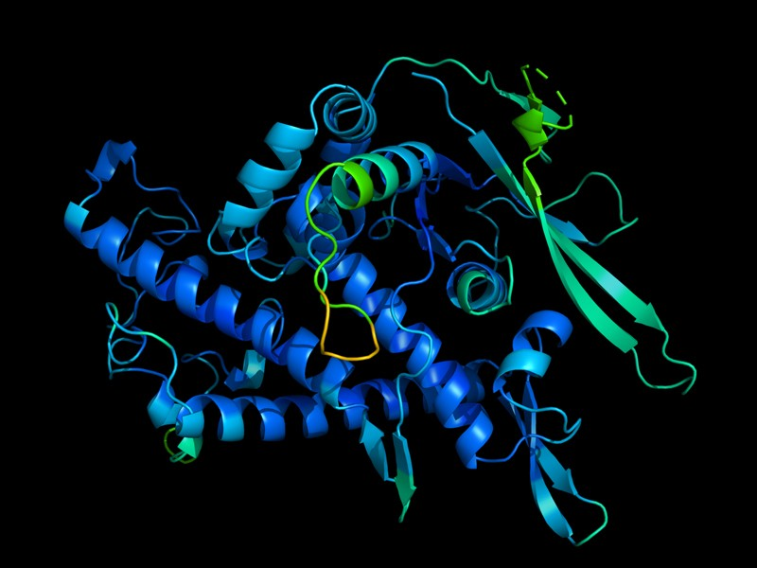
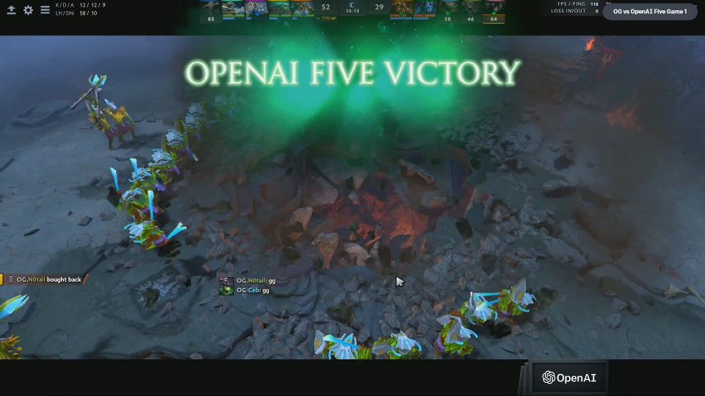
History of Game Machines
18th century: The Turk: Fake chess machine
1970ies: First chess programs
1997: Deep Blue beats chess world champion
2015: DeepMind solved all Atari Games (Agent 57)
2016: AlphaGo beats Lee Sedol in the Game of GO
2017: OpenAI wins Dota2 in 1on1
2019: OpenAI wins Dota2 in 5on5
2020 Deep Mind solved Proteinfolding
Notes:
Game of GO 10^360 states vs Chess 10^123 Sates

Slide 5
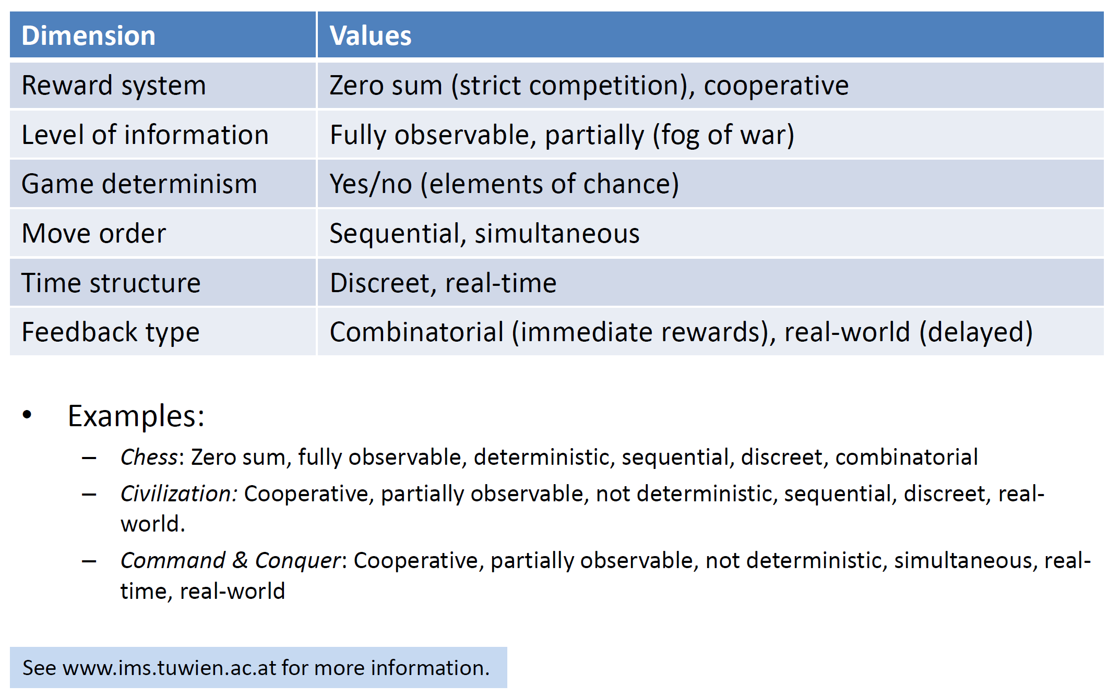
What Makes a Game?

Slide 6
Algorithmic Concepts & Terms
What makes a strategy?
Rules, freedom of choice, rewards for actions
Search strategies:
Dumb fast (e.g Minimax) -> Exhaustive tree search (trying out all moves)
Smart slow (e.g MCTS)
Search stability:
Fail hard: deterministic, stable, expensive
Fail soft: probabilistic, heuristic, unstable, cheaper

Slide 7
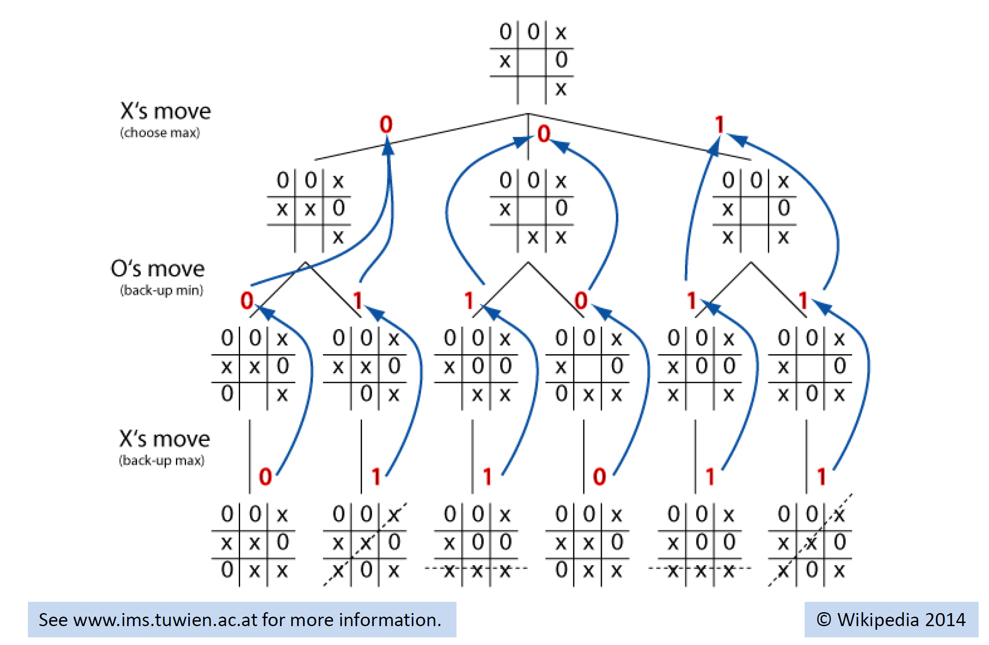
tic toe- Dumb Fast: Minimax Algorithm
Notes:
Game Trees are just trees, and nodes are game states.
Finding future positions that are favorable or unfavorible (e.g. number of chess elements on the board)
If the tree branches really wide, then the tree cannot be rolled out anymore,
That is the case of game of GO
Game of GO 10^360 states vs Chess 10^123 Sates

Slide 8
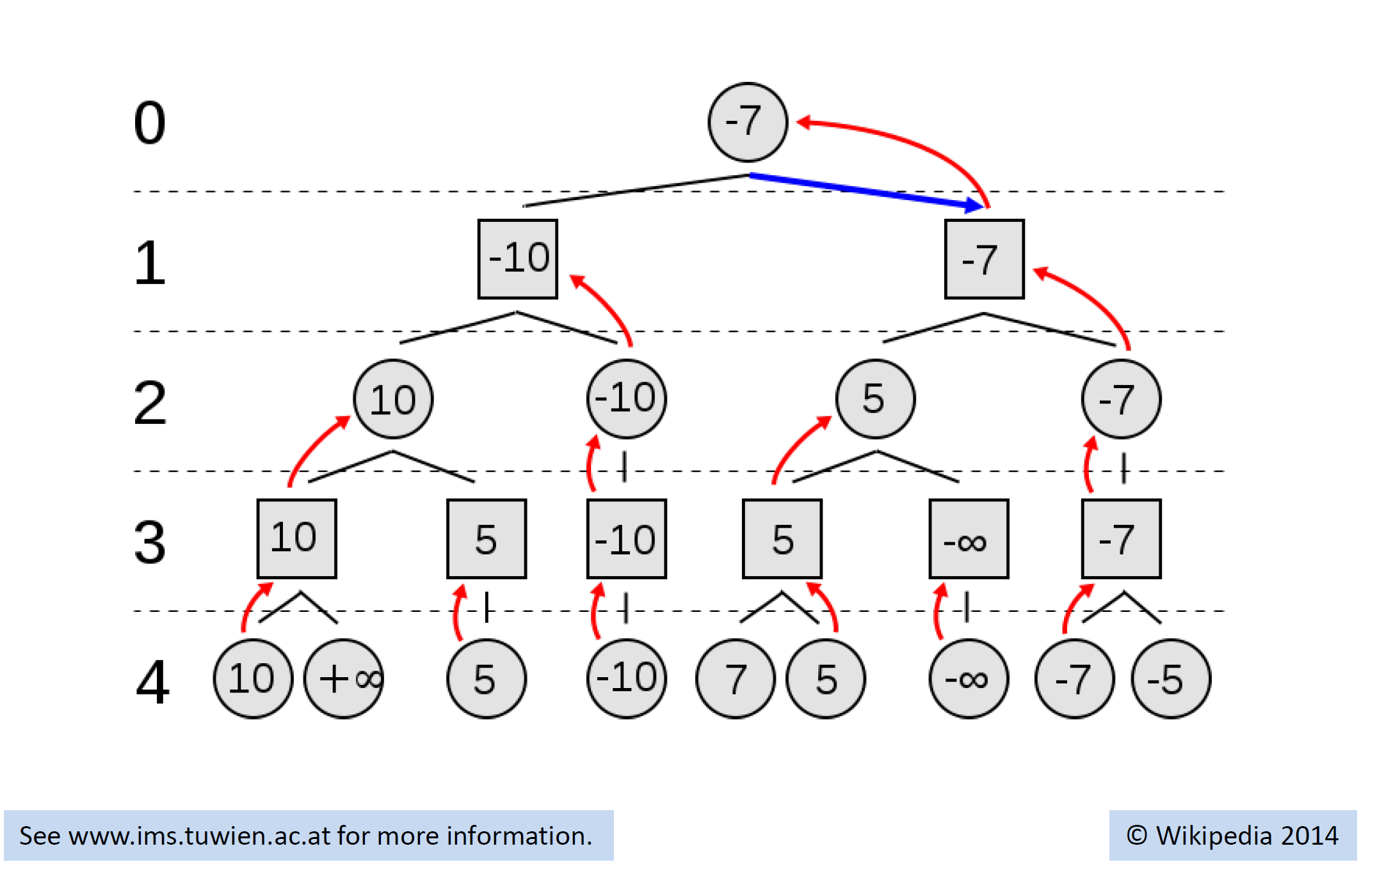
Numeric Example

Slide 9
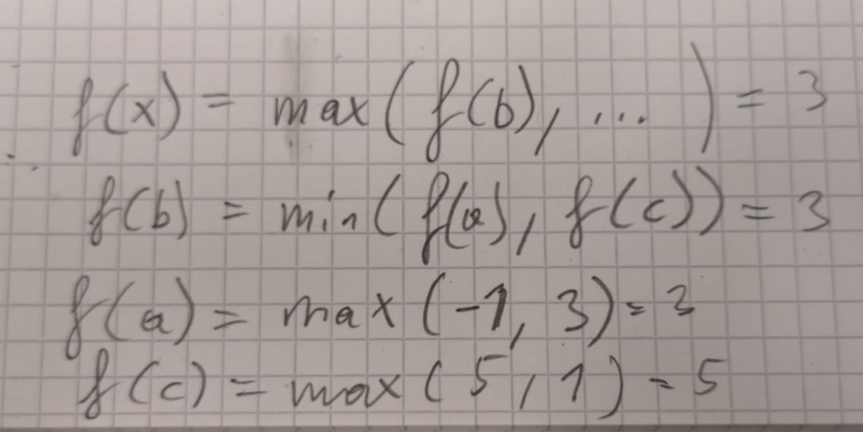
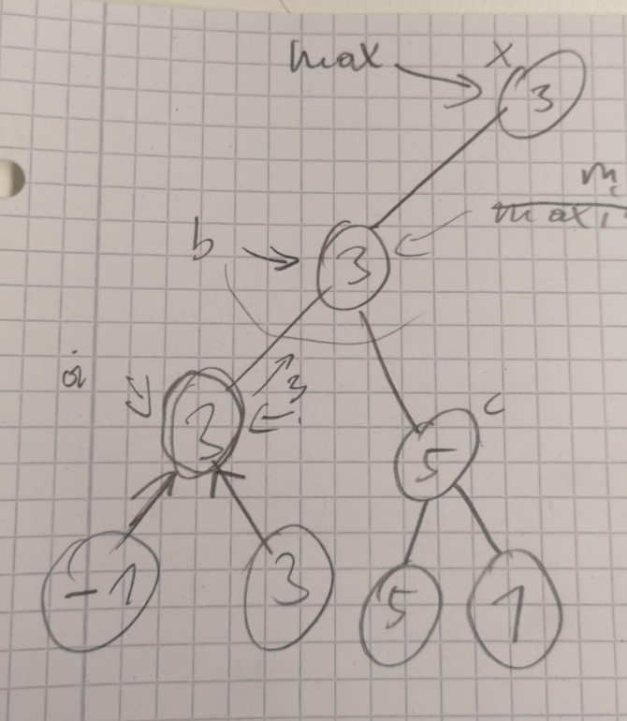
Minimax all you need is a recursive function f(gamestate,player) to evaluate the value of every move that is currently possible.
https://www.youtube.com/watch?v=l-hh51ncgDI&t=250s&ab_channel=SebastianLague
Notes:
man muss nur eine funktion f (gameposition, currentplayer) schreiben die jeweils alle moves in einer gameposition auswertet und dann je nach currentplayer das minimum oder das maximum der bewerteten moves zurückgibt.

Slide 10
Alpha Beta Pruning
Idea do not explore paths when the player in the current position would never go that way.
This can happen when doing the move would provide the opponent with a higher scoring move as already observed in the other branch.
https://www.youtube.com/watch?v=l-hh51ncgDI&t=250s&ab_channel=SebastianLague

Slide 11
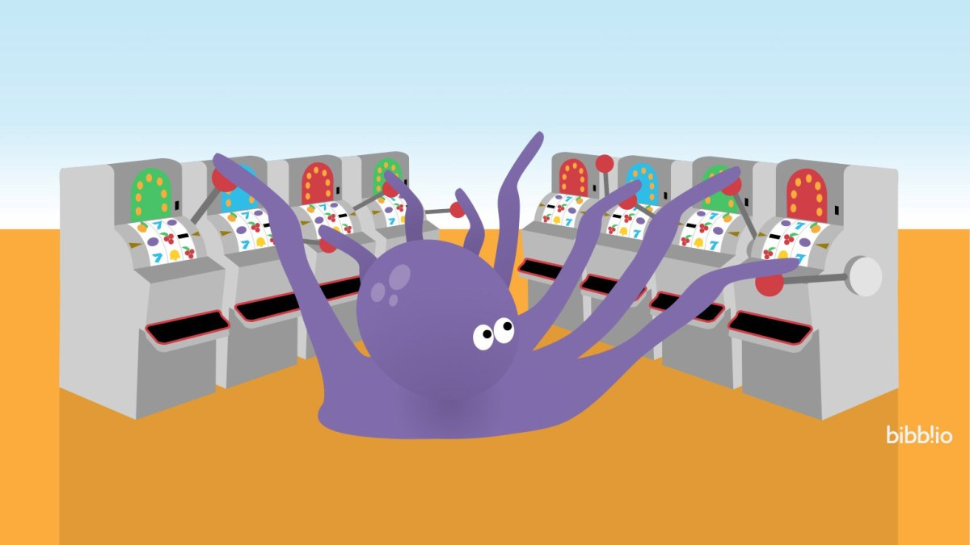
Bandit Based Methods
Exploration Only
Exploitation Only
Epsilon Greedy
https://www.youtube.com/watch?v=e3L4VocZnnQ&ab_channel=ritvikmath
Notes:
Exploration Only -> Pure Random
Exploitation Only -> Test each machine once, and then use only the machine with hightest reward on that run.
Epsilon Greedy (balance exploration vs exploitation, e.g Randomly Pick a machine in 10% of the cases, vs 90% picking the machine with highest mean reward so far.

Slide 12
UCB 1 Strategy
When you are uncertain about your estimate of the value of a move.
At each Time t, Pick Move such that
Mü_r + sqrt(2ln(t)/N_t(r)) is maximized
Where mü_r is the expoitation and the rest is the exporation.
https://www.youtube.com/watch?v=FgmMK6RPU1c&ab_channel=ritvikmath
Notes:
When you are uncertain about your estimate of the value of a move.
At each timepoint t> you pick the restaurant r such that…
Benefit of the doubt, lets try a move again when not tried often.

Slide 13
Monte Carlo Tree Search
MCTS creates a statistics tree (describing the value of a position)
Idea is to focus the search time to more relevant options.
It comes up with these values by simulating steps (first random later more expoiting)
Selection, Expansion, Simulation, Update
Open Ended Environments (no domain dependent evaluation function required)
Notes:
https://www.youtube.com/watch?v=Fbs4lnGLS8M&ab_channel=FullstackAcademy

Slide 14
Alpha Zero & Monte Carlo Tree Search
Works similar to the human way of playing … looking at promising moves (simulating the next steps) ignoring obviously bad moves.
Value Network -> Takes Game State as Input -> outputs value of that state. Very simple function approximation from sequences.
Policy Network -> trained such that the output is the same as MCTS
MCTS uses Policy Network to determine which positions are promissing
Notes:
https://www.youtube.com/watch?v=MPXGiowUr0o&ab_channel=SkowstertheGeek
https://www.youtube.com/watch?v=62nq4Zsn8vc&ab_channel=JoshVarty

Slide 15
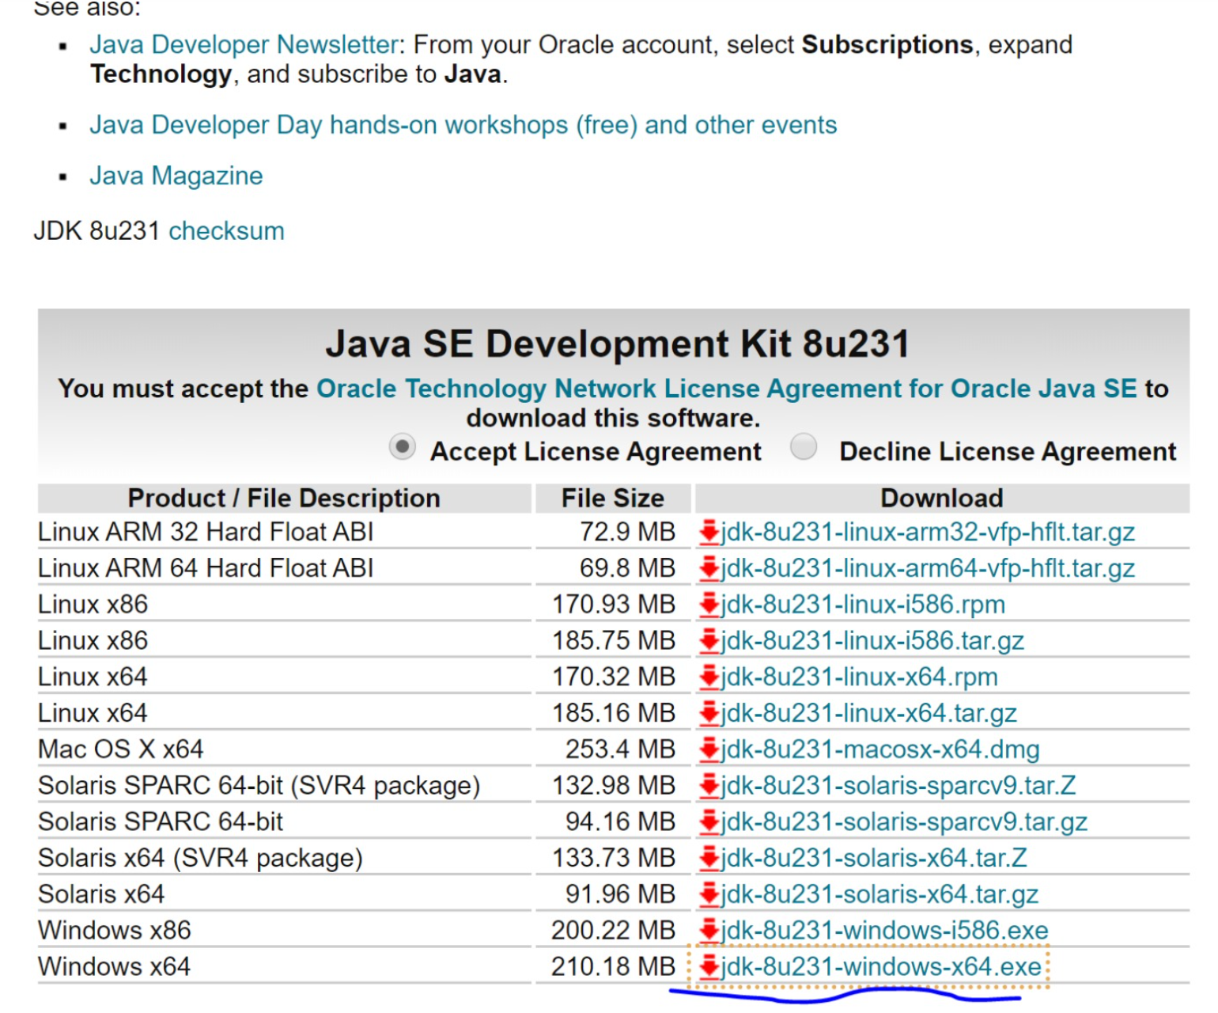
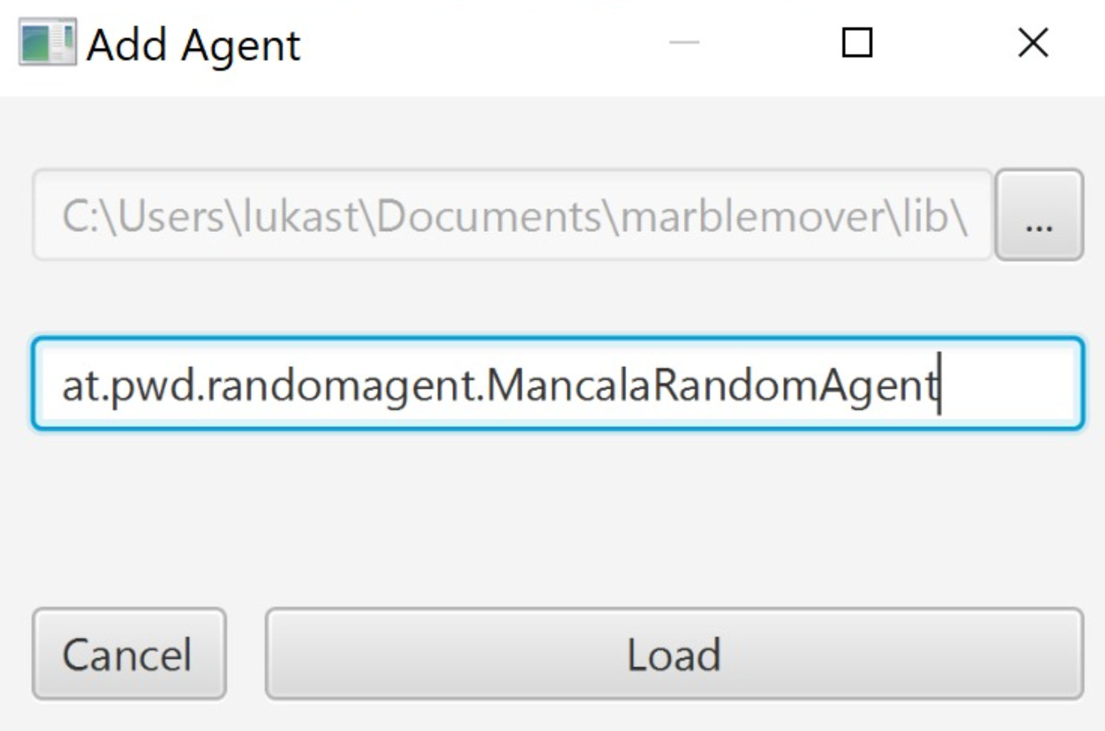
Game of Mancala
https://github.com/metzzo/mancala
Notes:
[08:44, 20.12.2019] Lukas Steindl: habs jetzt auf einem neuen rechner installiert und mal wieder a zeitl braucht bis es überhaupt lauft... zur Doku: man braucht unbedingt das JDK hier: und die JAVA_HOME variable muss auf das installationsverzeichnis dann zeigen exklusive \bin am ende[08:45, 20.12.2019] Lukas Steindl: bzgl. des problems dass er den agent nciht laden kann... ich hab die agent config ganz rauswerfen müssen um es überhaupt starten zu können... d.h im config file muss es zu beginn so aussehen:[08:45, 20.12.2019] Lukas Steindl: <config> <agents/> <computation-time>5</computation-time> <stones-per-slot>4</stones-per-slot> <slots-per-player>4</slots-per-player></config>

Slide 16
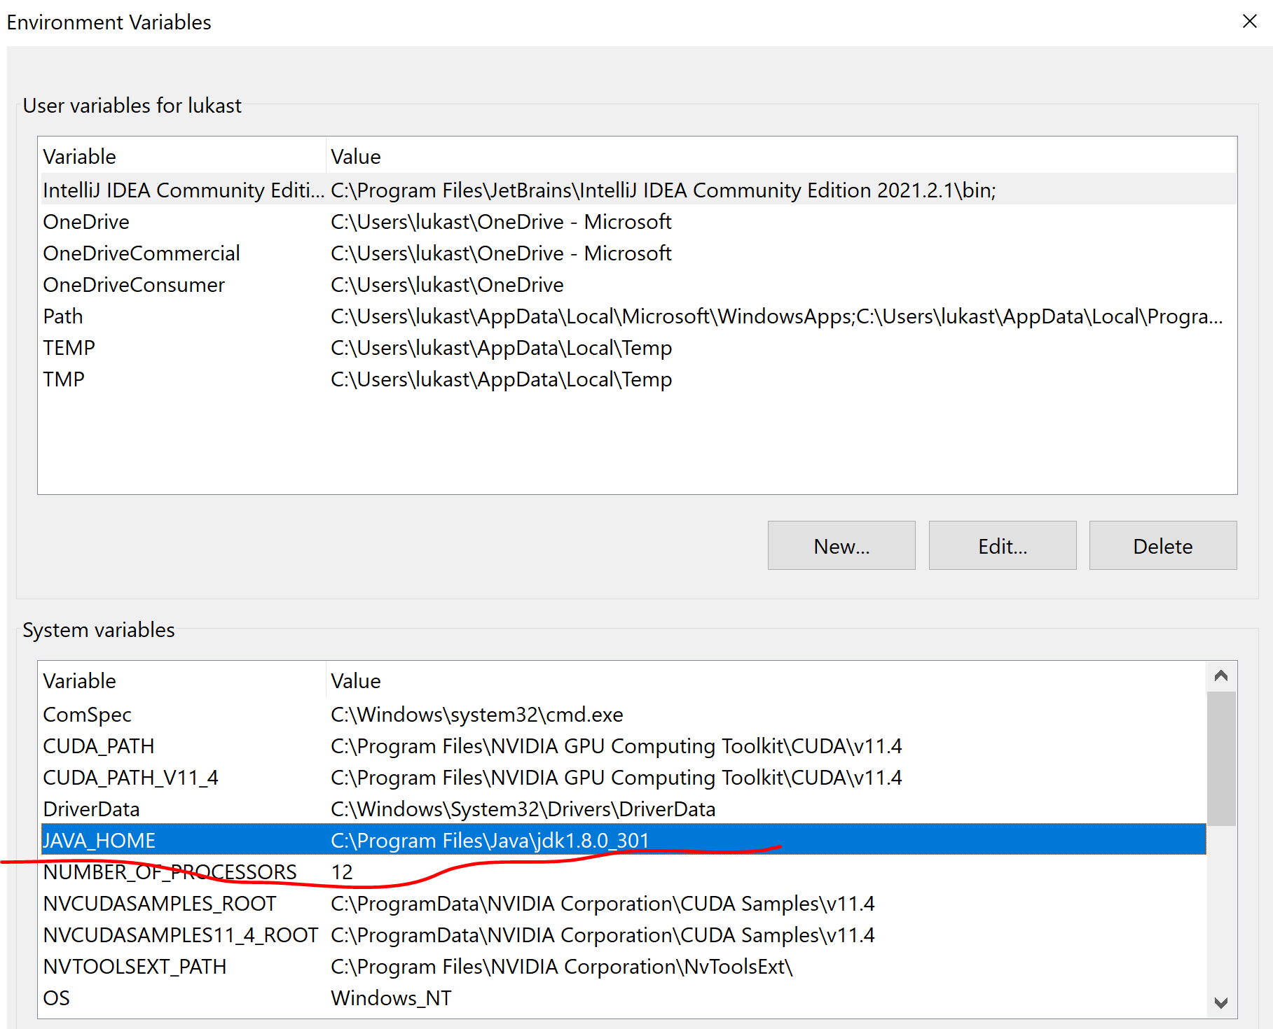
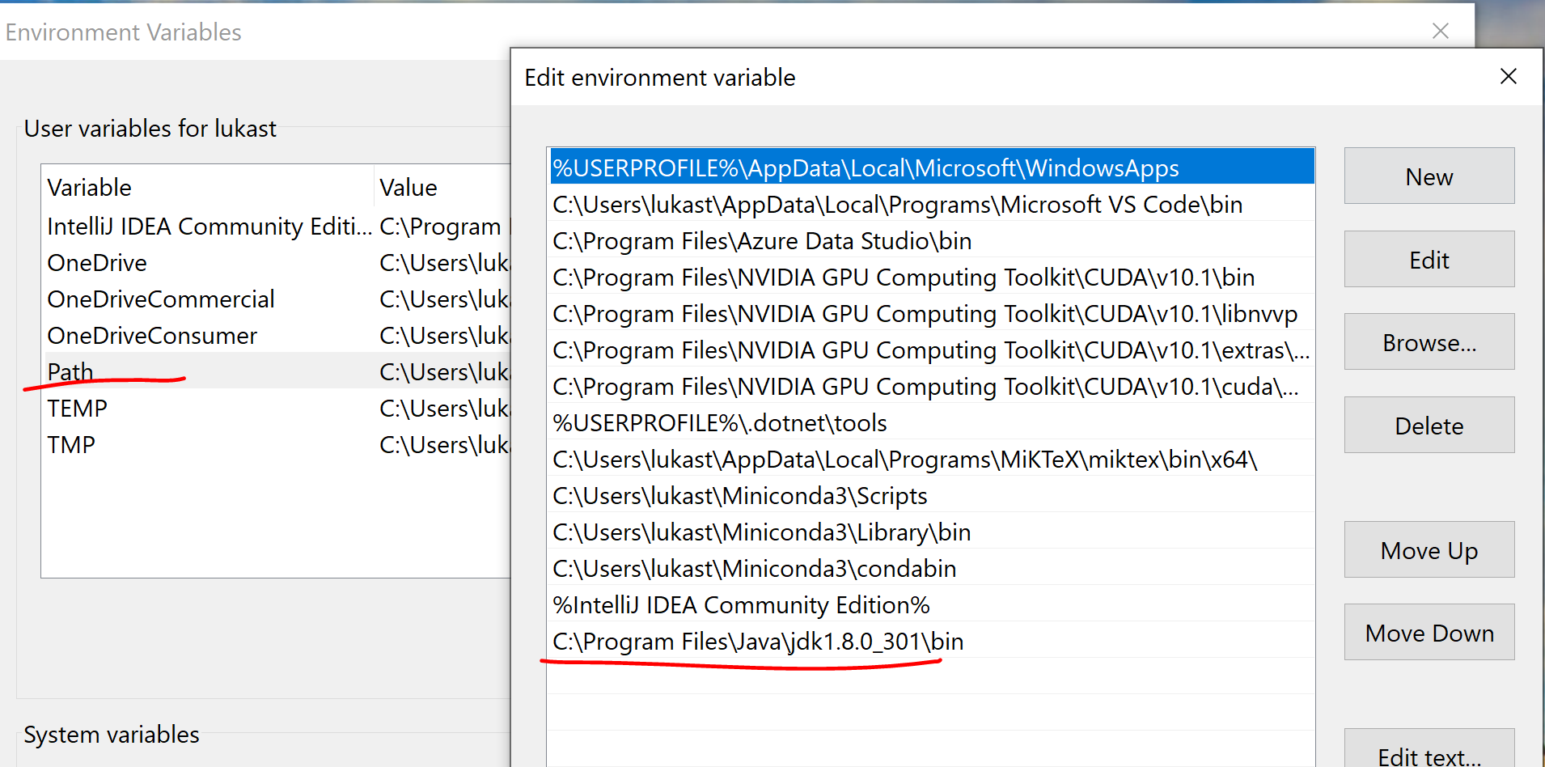
Environment Config

Slide 17
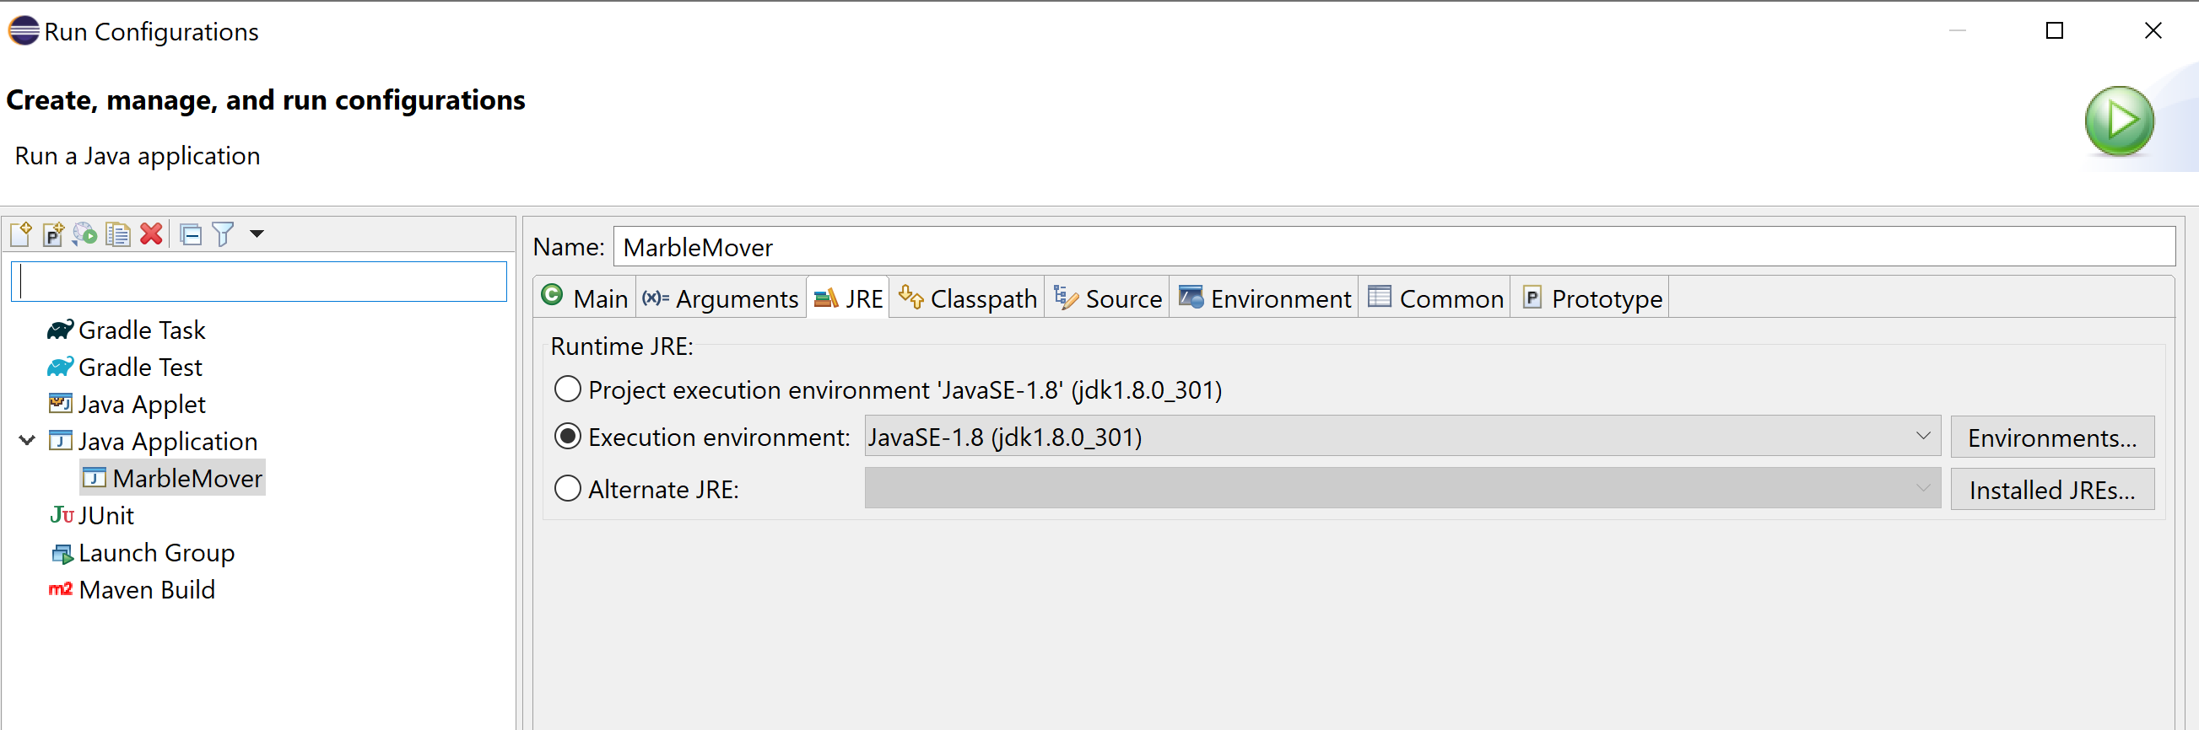
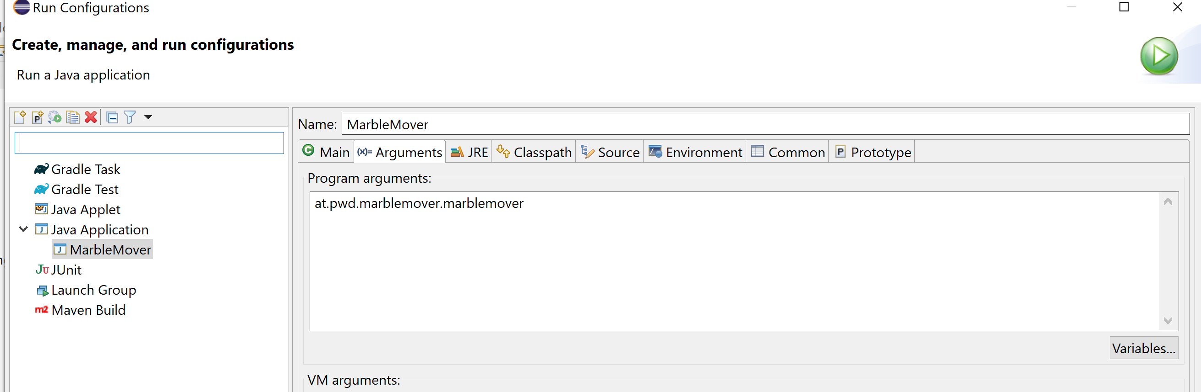
Eclipse Run Configuration

Slide 19
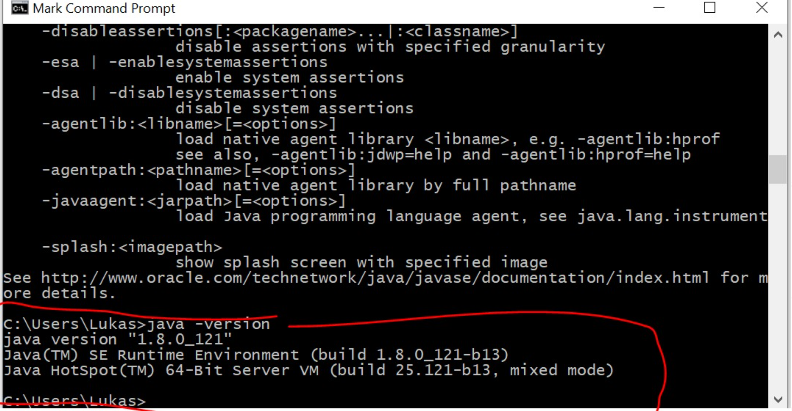
Notes:
Make sure classpath is set so that windows finds java.exe

Slide 20
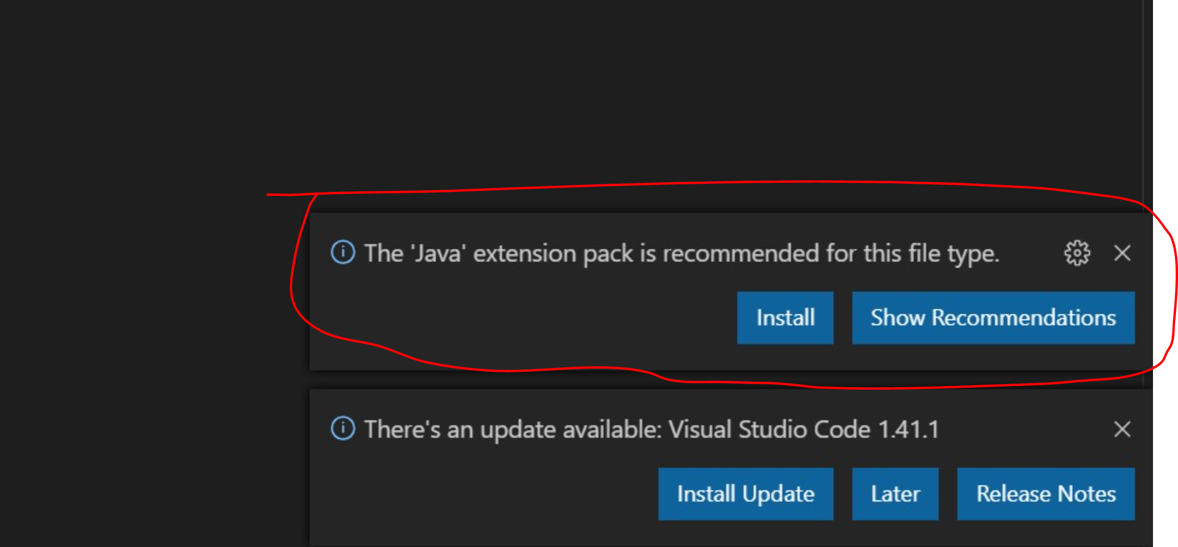
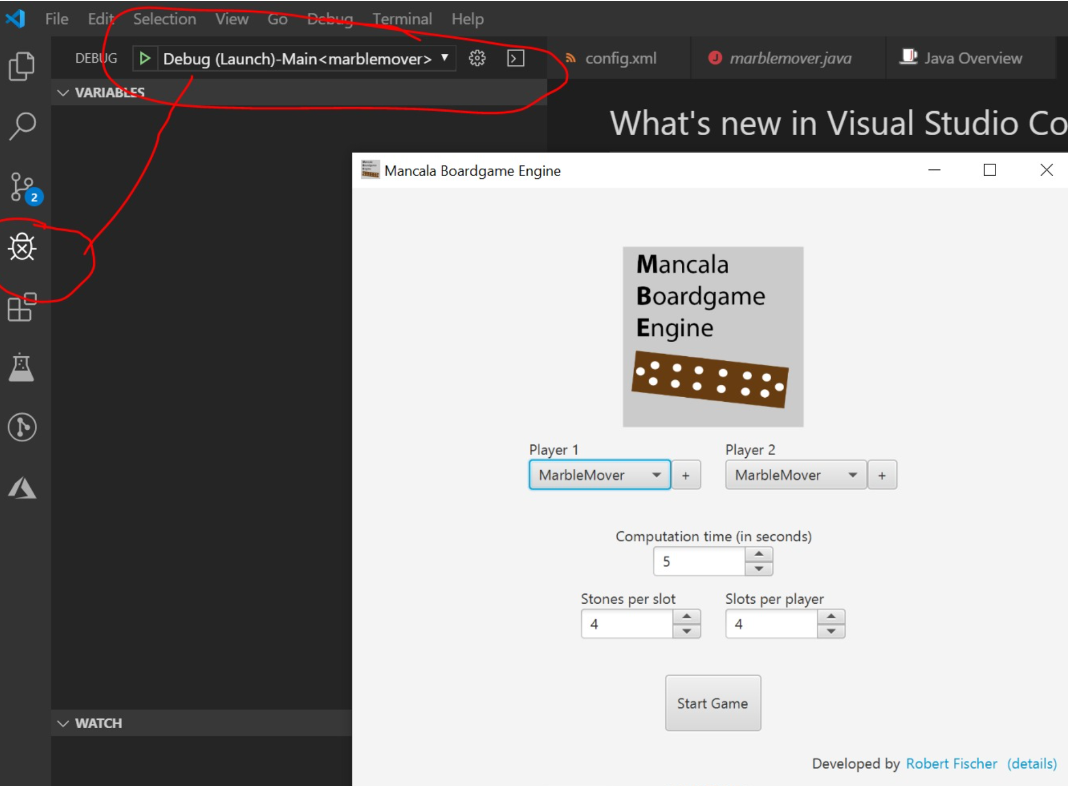
Notes:
ma muss nur diese vs code java extension installieren die er einem vorschlägt wenn man ein java sourcefile öffnet

Slide 21
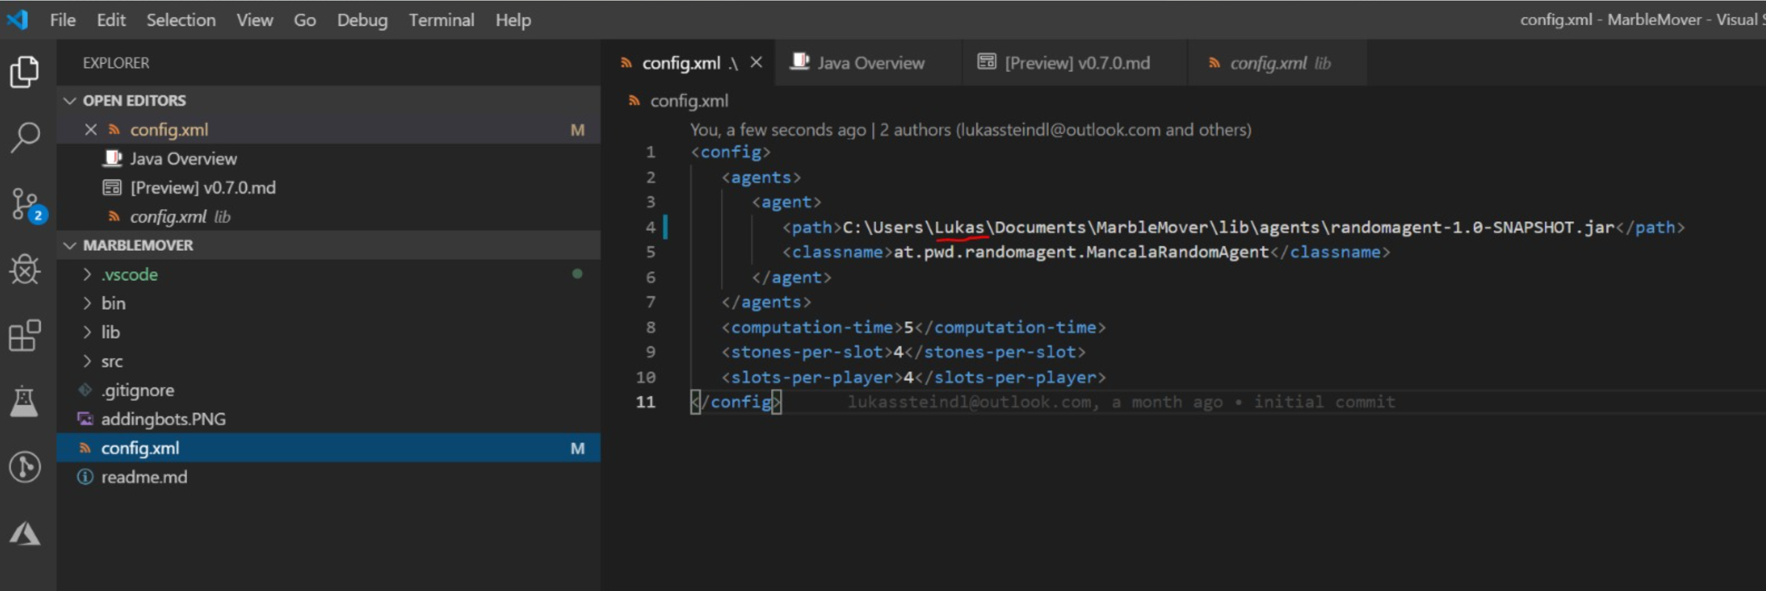

Slide 22
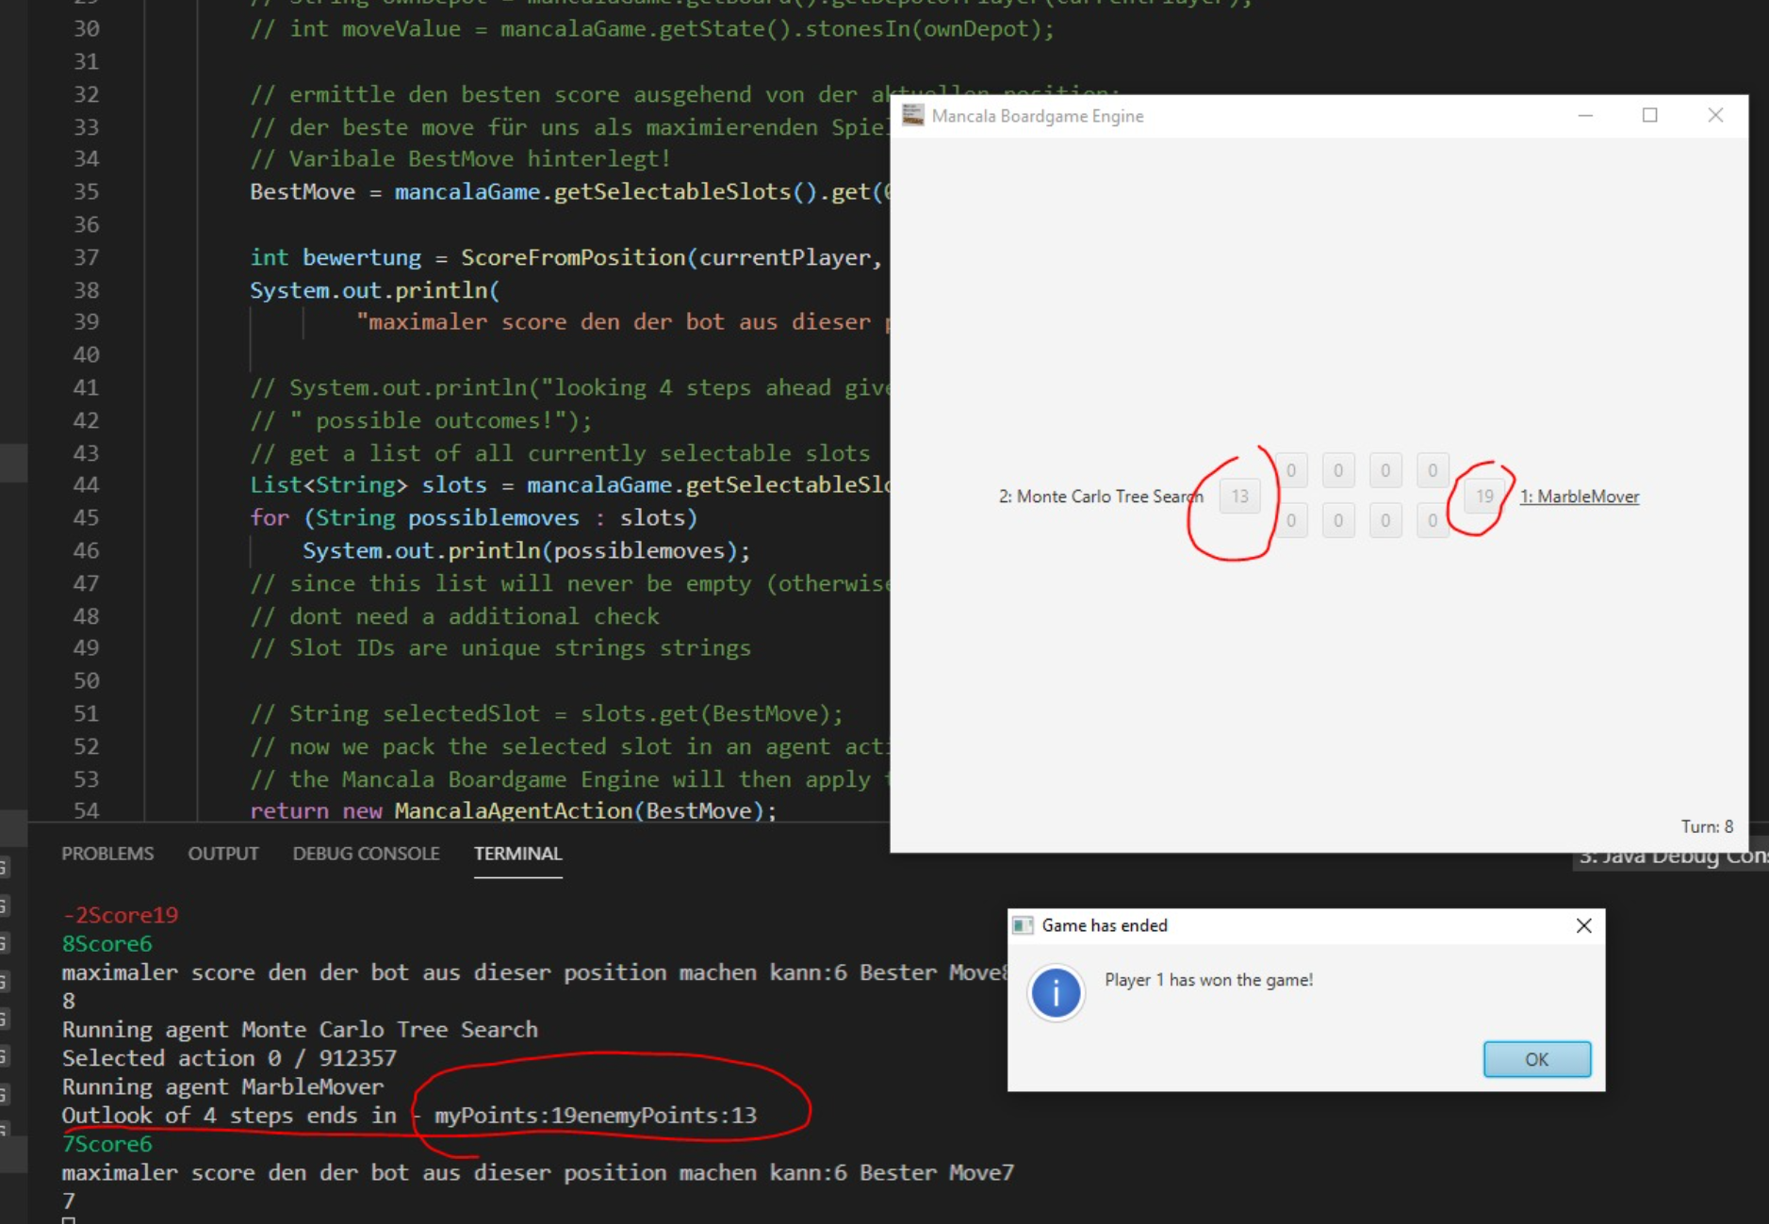
Notes:
Solution:
package at.pwd.marblemover;import java.util.List;import at.pwd.boardgame.game.base.WinState;import at.pwd.boardgame.game.mancala.MancalaGame;import at.pwd.boardgame.game.mancala.MancalaBoard;import at.pwd.boardgame.game.mancala.agent.MancalaAgent;import at.pwd.boardgame.game.mancala.agent.MancalaAgentAction;public class marblemover implements MancalaAgent { public static final String ANSI_RESET = "\u001B[0m"; public static final String ANSI_BLACK = "\u001B[30m"; public static final String ANSI_RED = "\u001B[31m"; public static final String ANSI_GREEN = "\u001B[32m"; public static final String ANSI_YELLOW = "\u001B[33m"; public static final String ANSI_BLUE = "\u001B[34m"; public static final String ANSI_PURPLE = "\u001B[35m"; public static final String ANSI_CYAN = "\u001B[36m"; public static final String ANSI_WHITE = "\u001B[37m"; public String BestMove = ""; @Override public MancalaAgentAction doTurn(int computationTime, MancalaGame mancalaGame) { // wer bin ich? int currentPlayer = mancalaGame.getState().getCurrentPlayer(); // System.out.println(ANSI_GREEN + currentPlayer + ANSI_RESET); // String ownDepot = mancalaGame.getBoard().getDepotOfPlayer(currentPlayer); // int moveValue = mancalaGame.getState().stonesIn(ownDepot); // ermittle den besten score ausgehend von der aktuellen position: // der beste move für uns als maximierenden Spieler wurde dann in der globalen // Varibale BestMove hinterlegt! BestMove = mancalaGame.getSelectableSlots().get(0); int bewertung = ScoreFromPosition(currentPlayer, mancalaGame, 4); System.out.println( "maximaler score den der bot aus dieser position machen kann:" + bewertung + " Bester Move" + BestMove); // System.out.println("looking 4 steps ahead gives" + TotalNumberOfLeaveNodes + // " possible outcomes!"); // get a list of all currently selectable slots List<String> slots = mancalaGame.getSelectableSlots(); for (String possiblemoves : slots) System.out.println(possiblemoves); // since this list will never be empty (otherwise the game would be over), we // dont need a additional check // Slot IDs are unique strings strings // String selectedSlot = slots.get(BestMove); // now we pack the selected slot in an agent action and return it // the Mancala Boardgame Engine will then apply this action onto the slot return new MancalaAgentAction(BestMove); } public int ScoreFromPosition(int currentPlayer, MancalaGame m, int depth) { depth = depth - 1; // init best move to leftmost move int maximumScoreSoFar = -1000000; int minimumScoreSoFar = 1000000; // wenn man auf der Blattebene angekommen ist weil die tiefe erschöpft ist oder // ein spieler gewonnen hat. if (depth == 0 || m.checkIfPlayerWins().getState() != WinState.States.NOBODY) { // hier schauen welcher Spieler wieviele Punkte hätte! MancalaBoard BoardInNMoves = m.getBoard(); String myDepot = BoardInNMoves.getDepotOfPlayer(currentPlayer); String enemyDepot = BoardInNMoves.getDepotOfPlayer(1 - currentPlayer); int myPoints = m.getState().stonesIn(myDepot); int enemyPoints = m.getState().stonesIn(enemyDepot); System.out.println("Outlook of 4 steps ends in - myPoints:" + myPoints + "enemyPoints:" + enemyPoints); return myPoints - enemyPoints; } else { boolean maximizing = false; // color each own move green and each enemy move red. if (m.getState().getCurrentPlayer() == currentPlayer)// { // maximizing maximizing = true; for (String s : m.getSelectableSlots()) { // gib den aktuellen move aus und führe diesen in einer kopie des spiels aus: MancalaGame gamecopy = new MancalaGame(m); // aus dem alphabeta-agent abgeschaut um jeweils den currentplayer in der game // instanz zu setzen boolean moveAgain = gamecopy.selectSlot(s); if (!moveAgain) gamecopy.nextPlayer(); // stell dir vor der nächste schritt ist der letzte... dann erhält man aus der // funktion einen positiven wert wenn der aktuelle bot mehr punkte als der // gegner hat! int currentScore = ScoreFromPosition(currentPlayer, gamecopy, depth); if (maximizing) { System.out.println(ANSI_GREEN + new String(new char[(depth - 3) * -1]).replace("\0", "-") + s + "Score" + currentScore + ANSI_RESET); } else { System.out.println(ANSI_RED + new String(new char[(depth - 3) * -1]).replace("\0", "-") + s + "Score" + currentScore + ANSI_RESET); } // take maximum score from position as current return value: // wenn man maximierender spieler ist, wählt man den move der den höchsten // positiven wert liefert! if (currentScore > maximumScoreSoFar) { maximumScoreSoFar = currentScore; if (depth == 3)// bestmove darf nur ganz oben gesetzt werden! BestMove = s; } if (currentScore < minimumScoreSoFar) { minimumScoreSoFar = currentScore; } // rufe nun rekursiv die selbe methode aus // numberOfLeaves = numberOfLeaves + ScoreFromPosition(currentPlayer, gamecopy, // depth, numberOfLeaves); } if (maximizing) return maximumScoreSoFar; else return minimumScoreSoFar; } } @Override public String toString() { return "MarbleMover"; }}

Slide 23
Game Environments: Gym
Open AI Framework
Atari Games
Classic Control problems -> good for testing
Board Games
...

Slide 24
Development Environment Options
Directly on your Windows Desktop Client
Azure Data Science VM
Docker
Azure ML
C:\Users\lukast\Documents\mln
C:\Users\lukast\Documents\machinelearningnotebooks
Windows /Linux Dual Boot
Linux Subsystem -> just no
Notes:
Docker -> Resource Intensive & Slow -> GPU Configuration may take ages!
Directly on Windows Desktop Client -> big issues with Gym Framework
Azure ML -> Black Box (uses Docker in the background) 3 Month tutorial fails without error message -> some trial & error to identify again that the docker environment causes problems.
Azure Datascience VM -> simples Option for Learning Purpose (Downside -> fast aging image (many libraries update frequently) – often easier to create a new vm after a while than patching the existing one.

Slide 25
Model Based vs Model Free
Model Free
-> Directly Predicting the Action from the Observation
Used in complex (also stochastic environments)
Model Based
-> tries to predict the next observation and reward, (often multiple times) and then decides what action to take
Used in deterministic environments

Slide 26
Policy Based vs Value Based
Policy Based -> Predicting a probability distribution over the next actions
Value Based -> Predicting the value of the next action

Slide 27
On-Policy vs Off-Policy
On Policy – directly learning from the environment
Off Policy -> Learning from historical data e.g obtained by a previous version of the agent, or human recorded.)

Slide 28
Cross Entropy Method
Play N episodes using the current model and environment
Calculate reward for every episode
Keep only the top 70% of the episodes by reward
Train neural net on these “elite” episodes taking state as input and action as output.
Repeat till convergence

Slide 29
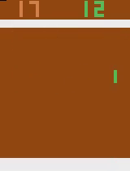
Pong

Slide 30
Pong
File "/opt/miniconda/lib/python3.7/site-packages/tensorflow/python/client/session.py", line 1149, in _run
str(subfeed_t.get_shape())))
ValueError: Cannot feed value of shape (4, 4, 4, 16) for Tensor 'default_policy/Placeholder_default_policy/conv1/kernel:0', which has shape '(8, 8, 4, 16)'
2021-08-25 15:51:15.470861: CPU Usage: 24.1%, Memory Usage: 6.0%, Memory Total/Available: 59074052096/55516184576
[2m[36m(pid=147)[0m /opt/miniconda/lib/python3.7/site-packages/tensorboard/compat/tensorflow_stub/dtypes.py:541: FutureWar

Slide 31
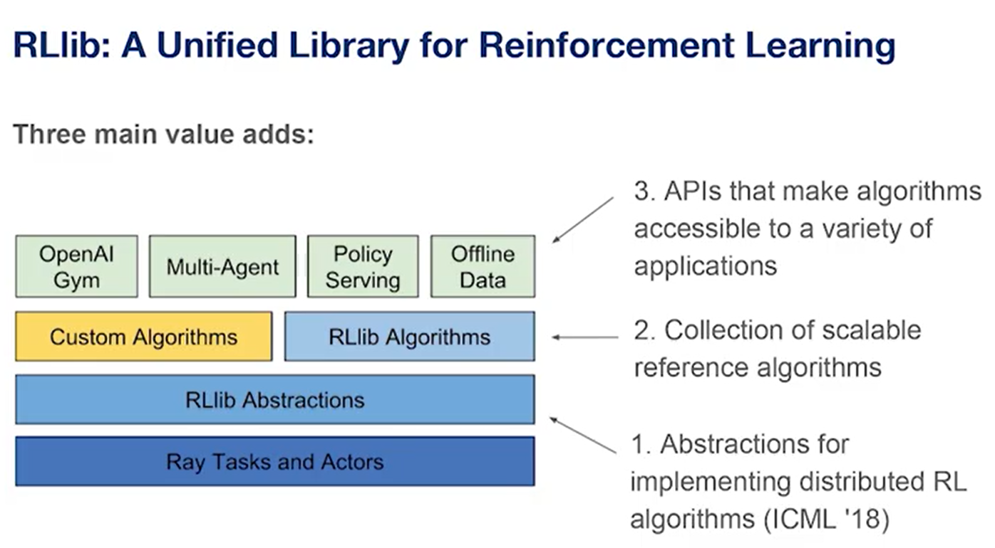
RAY

Slide 32
Reinforcement Learning (eventuell aus dem ML Kurs was rauskopieren)

Slide 33
Deep Learning
Hier das Beispiel mit Gradient Descent raussuchen (Deep learning for Vision)

Slide 34
Hands on -> Beispiel aus dem Buch
https://gym.openai.com/
Install with
pip install gym
pip install keras

Slide 35
https://techcommunity.microsoft.com/t5/azure-ai/introducing-reinforcement-learning-on-azure-machine-learning/ba-p/1403028
https://github.com/Azure/MachineLearningNotebooks/tree/master/how-to-use-azureml/reinforcement-learning
https://github.com/ray-project/ray

Slide 36
Issues I ran into
For the cartpole rl on sc demo I had some missing python packages in the docker image (resulting in an error when trying to capture the video) -> fixed this in a fork of the repo and created pull request
Missing Azure CLI for the Atari Distributed pong Demo
Install the Azure CLI for Windows | Microsoft Docs

